Slide 1

NETWORK
SUBNET

Slide 2
IPv4 Addressing Lesson 2: Network IDs and Subnet Masks - YouTube
Youtube videos
https://www.youtube.com/watch?v=8L23irhP0fc

Slide 3
BINARY
An octet
128
64
32
16
8
4
2
1
0 1 0 0 0 0 0 0
64
0 0 1 0 0 0 0 1
33
0 1 1 1 1 1 1 1
127
1 1 0 1 0 0 0 0
192
0 0 0 0 0 1 0 1
5

Slide 4
Network ID
192.168.1.0 / 24
11111111
11111111
11111111
00000000
255
255
255
0

Slide 5
Finding CIDR number
Mask
255.255.248.0
11111111
11111111
11111000
00000000
128+64+32+16+8 =248
128/64/32/16/8/4/2/1
8 bits
8 bits
5 bits
0 bits
Mask
255.255.248.0/21

Slide 6
Finding CIDR number
Mask
255.255.255.192
11111111
11111111
11111111
11000000
128+64 =192
128/64/32/16/8/4/2/1
8 bits
8 bits
8 bits
2 bits
Mask
255.255.255.192/26

Slide 7
Finding Network ID for
192.168.40.192
Mask
255.255.248.0/21
192.
168.
40.
0
255
255
00101000
8 =11111111
8=11111111
5=11111000
128/64/32/16/8/4/2/1
40 = 32+8
8+8+5 =21
Network ID
255.255.40.0/21
Third Octet macth two binary numbers
00101-000
11111-000
Since last 1 s match we use 40

Slide 8
Finding Network ID for
192.168.45.192
Mask
255.255.248.0/21
192.
168.
45.
0
255
255
00101101
8 =11111111
8=11111111
5=11111000
128/64/32/16/8/4/2/1
45 = 32+8+4+2+1
8+8+5 =21
Network ID
192.168.40.0/21
Third Octet macth two binary numbers
00101-101
11111-000
We match until the last 1 below

Slide 9
Finding Network ID for
192.168.45.55
Mask
255.255.255.192/26
192.
168.
45.
55
128/64/32/16/8/4/2/1
45 = 32+8+4+2+1
255 always = 192 here
255 always = 168 here
Third octet is network
so 45 stays here
00110111
8 =11111111
8=11111111
8=11111111
2=11000000
8+8+8+2 =26
Network ID
192.168.45.0/26
Fourth Octet macth two binary numbers
00-110111
11-000000
We match until the last 1 below

Slide 10
Finding Network ID for
202.10.133.11
Mask
255.255.255.0/24
202.
10.
133.
11
128/64/32/16/8/4/2/1
45 = 32+8+4+2+1
255 always = 192 here
255 always = 168 here
Third octet is network
so 133 stays here
00110111
8 =11111111
8=11111111
8=11111111
8+8+8+2 =26
Network ID
202.10.133.0/24

Slide 11
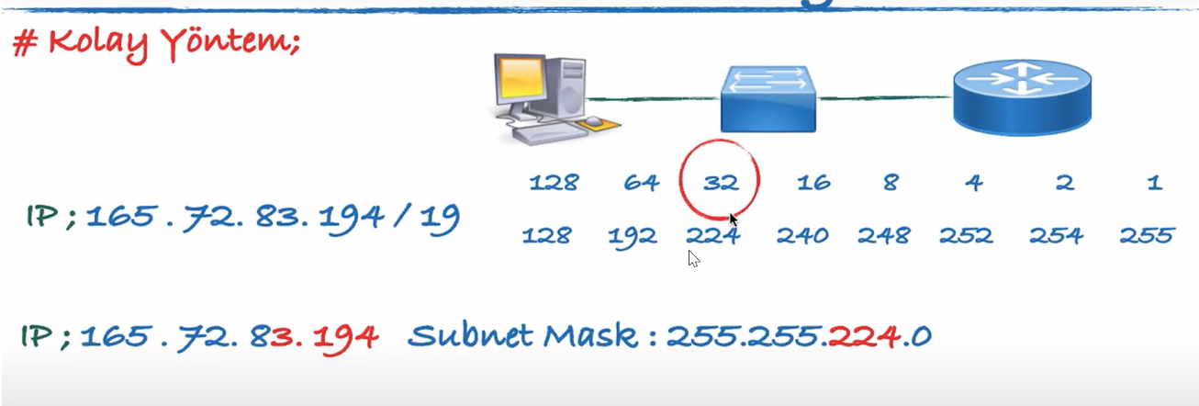

Slide 12
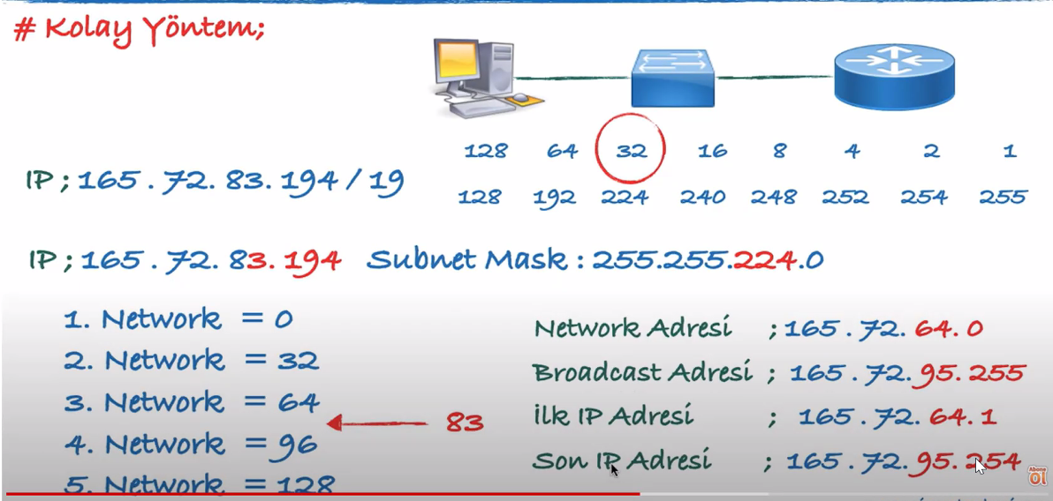

Slide 13
